Slide 1
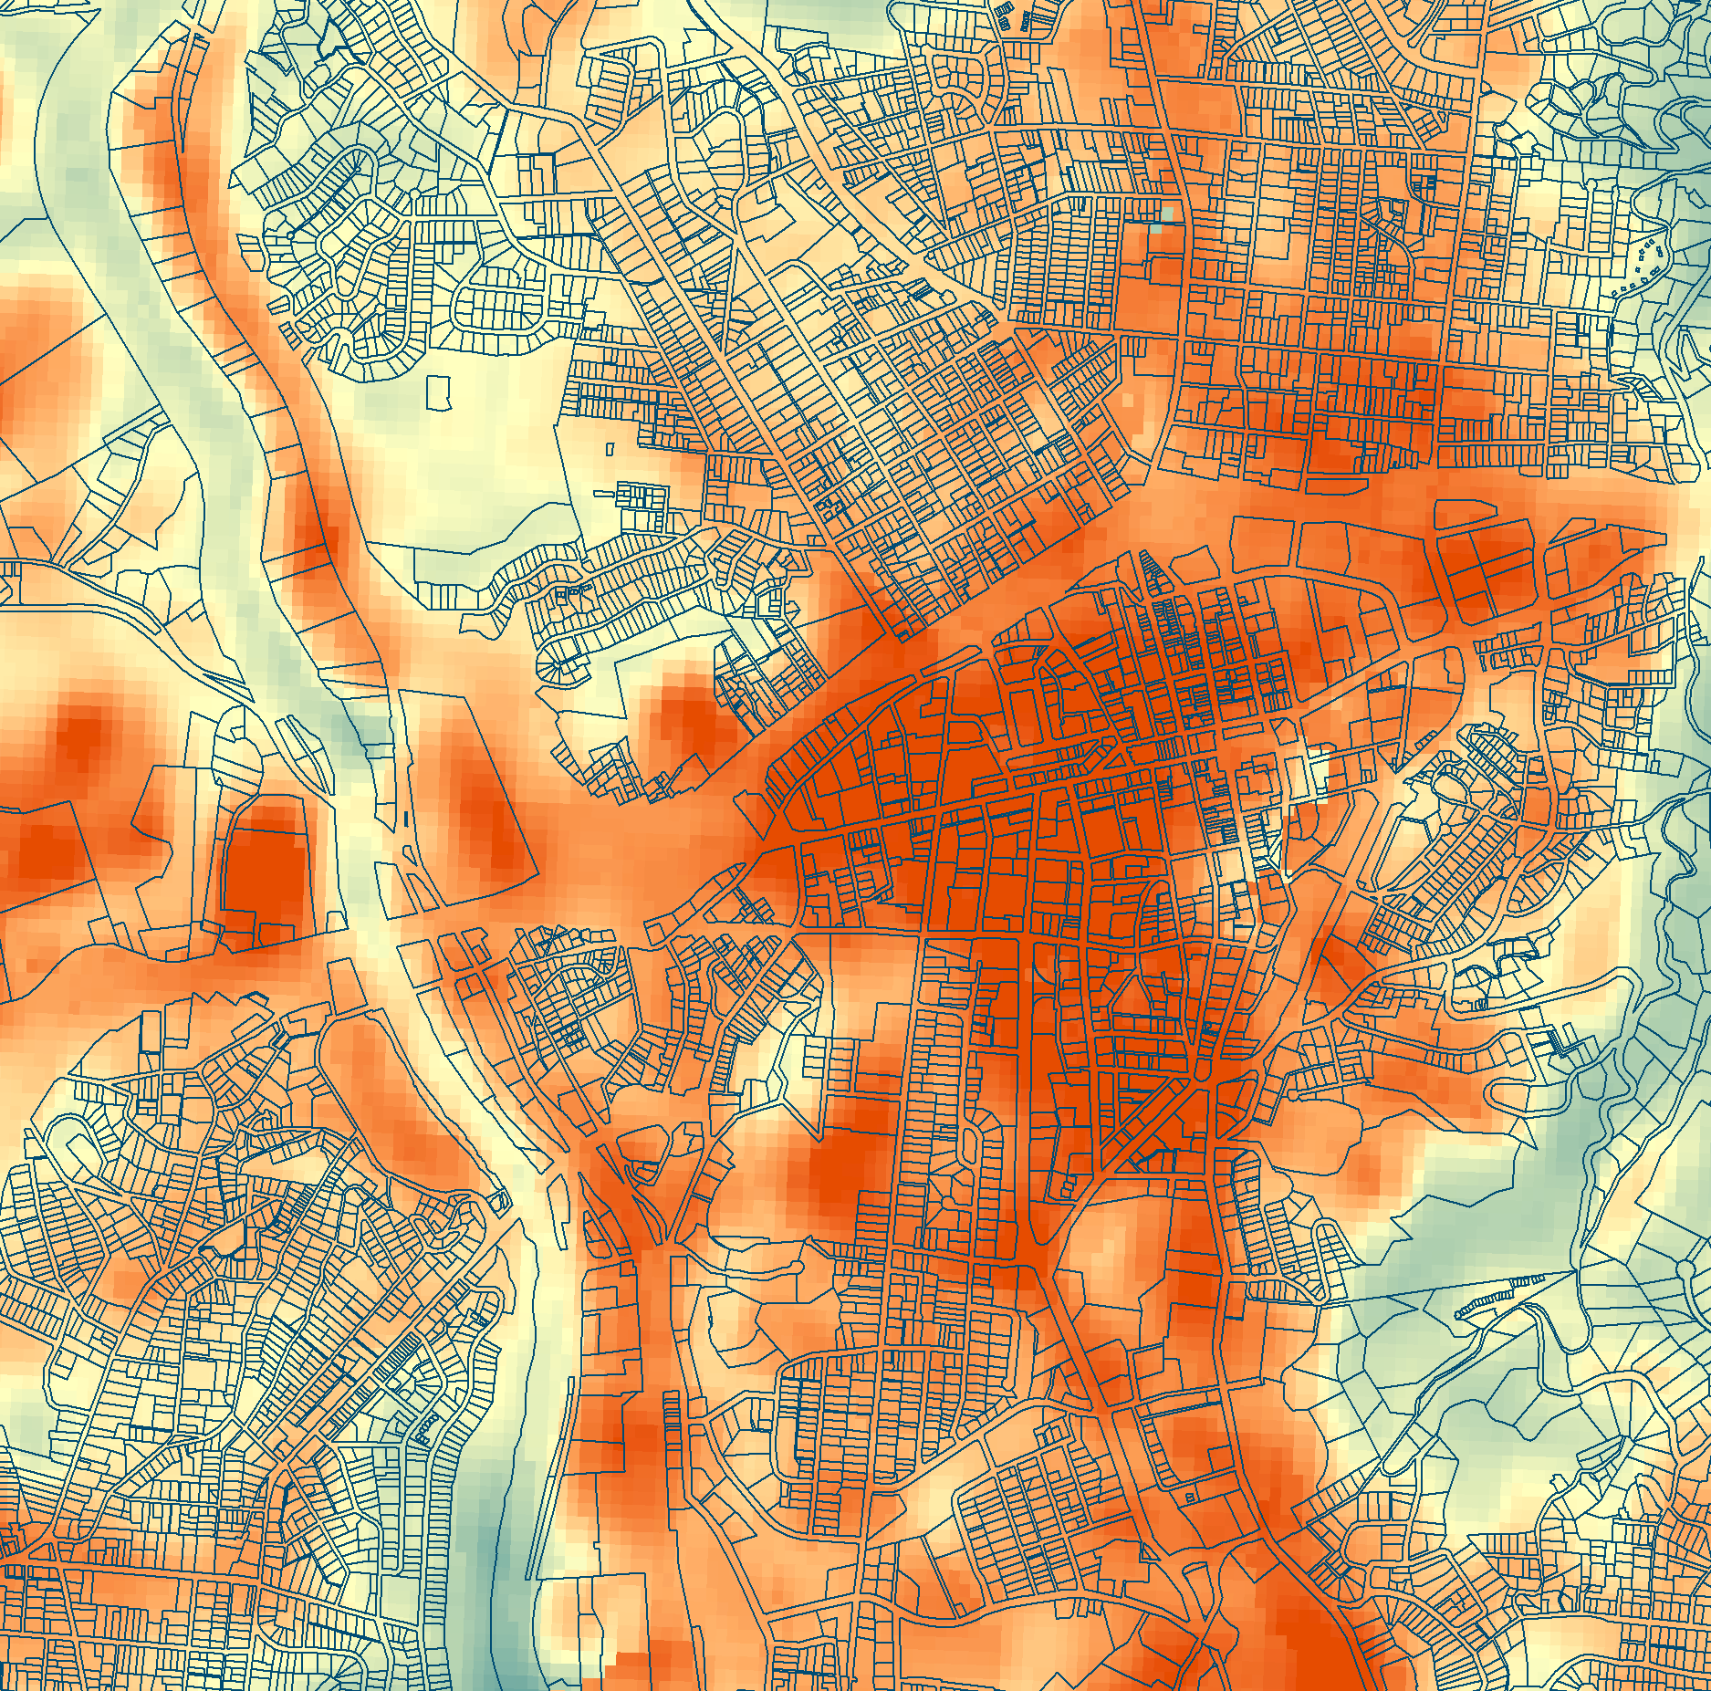
TREE COVER & URBAN HEAT ISLANDS IN ASHEVILLE
Using NASA Earth Observations to Quantify the Impact of Urban Tree Cover on Urban Heat and Identify Community Vulnerability in the City of Asheville
Darcy Gray
Amiya Kalra
Amy Kennedy
North Carolina – NOAA NCEI | Fall 2019
Notes:
I’m Darcy…
And as Dawn mentioned, we are part of the NASA DEVELOP program and we’re at the end of our 10-week project where we’ve partnered with the Urban Forestry Commission, and today we’ll be presenting some of our results to you.
In this whole discussion of urban tree cover and climate change, our role is to talk a little bit to you about the relationship between tree cover and temperature.
Landsat Land Surface Temperature (LST) for 2018 summer months derived using a Google Earth Engine Code. A section of Asheville is displayed. Red indicates areas with higher LST, blue represents lower LST and the pale yellow is in the middle of the color scale. Displayed over the LST are US census parcels outlines, available from http://us-city.census.okfn.org/dataset/parcels .

Slide 2
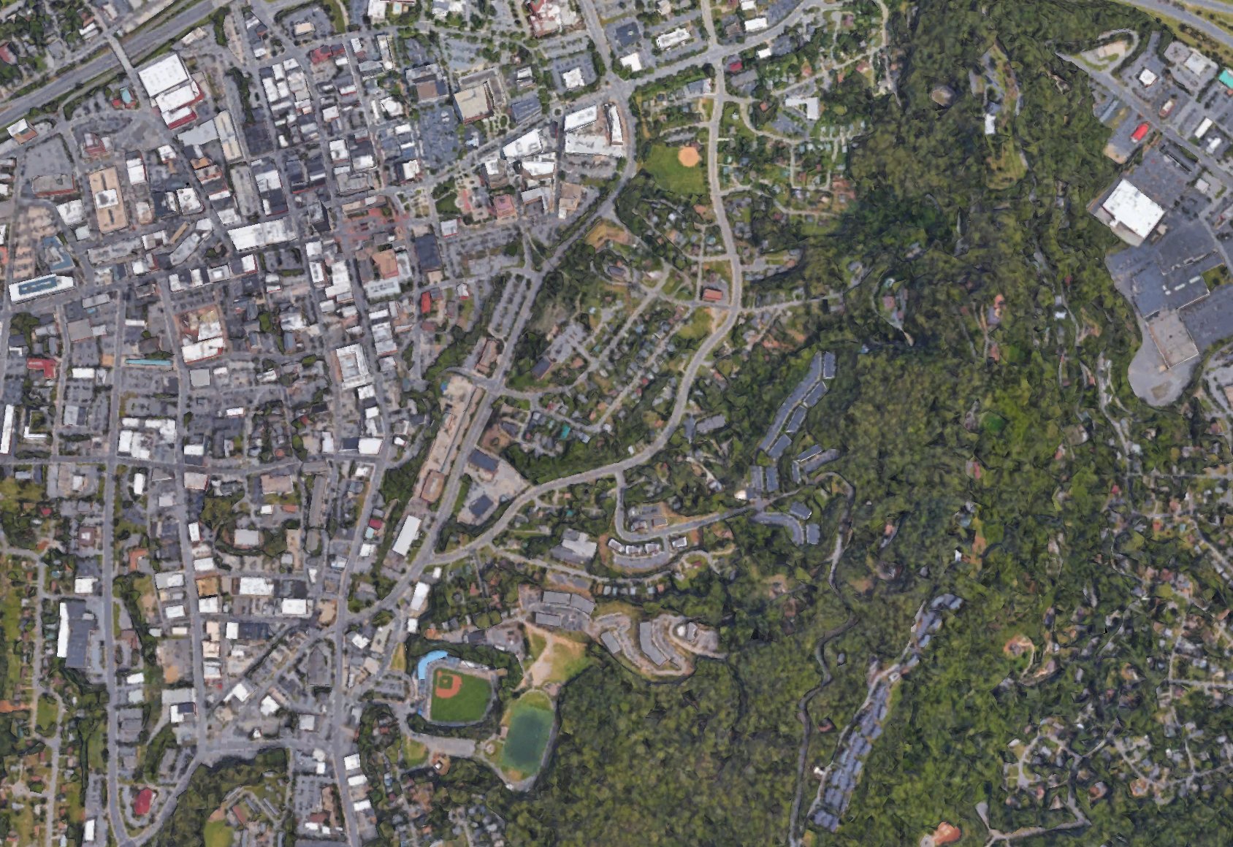
URBAN HEAT ISLANDS
Separate from climate change
Using satellite imagery to see fine-scale temperature differences
Image Credit: Google Earth
Notes:
As has been discussed already in this symposium, the Urban Heat Island effect is when an urban area experiences higher temperatures than its surroundings. Something we want to clarify is that the urban heat island effect is a phenomenon which exists separately from climate change, and is not caused by climate change or GHG emissions but by changes in land cover and land use. However, the UHI can be exacerbated by climate change, and as temperatures increase globally, the high temperatures experienced in a city will only be higher. You can think of it as a bit of a “one two punch”
To look at the UHI in Asheville, we didn’t have thermometers to take the temperature on every street, so we used the next best thing – satellite imagery. We want to emphasize that the data we’ll present is based off of NASA satellite-derived land surface temperature, and that not air temperature you're used to hearing about it, so it reflects the actual skin temperature of the earth and not the air, which means that the median temperature our data reflects for a black paved parking lot will be really high, maybe higher than you’d expect
Anyone who has ever walked barefoot from the grass onto a black pavement can attest to the dramatic shifts in LST. And again, that shift in LST is related to the temperature of the air above it, but the variation is more extreme. When you walk from the grass onto the pavement, your bare feet immediately perceive a temperature change but you’re not necessarily breaking an instant sweat.
So with that in mind, the temperature maps we’ll show you are reflection of that LST, but maybe theyr’e also reflective of what you feel in the air, but really they’re a proxy for temperature.

Slide 3
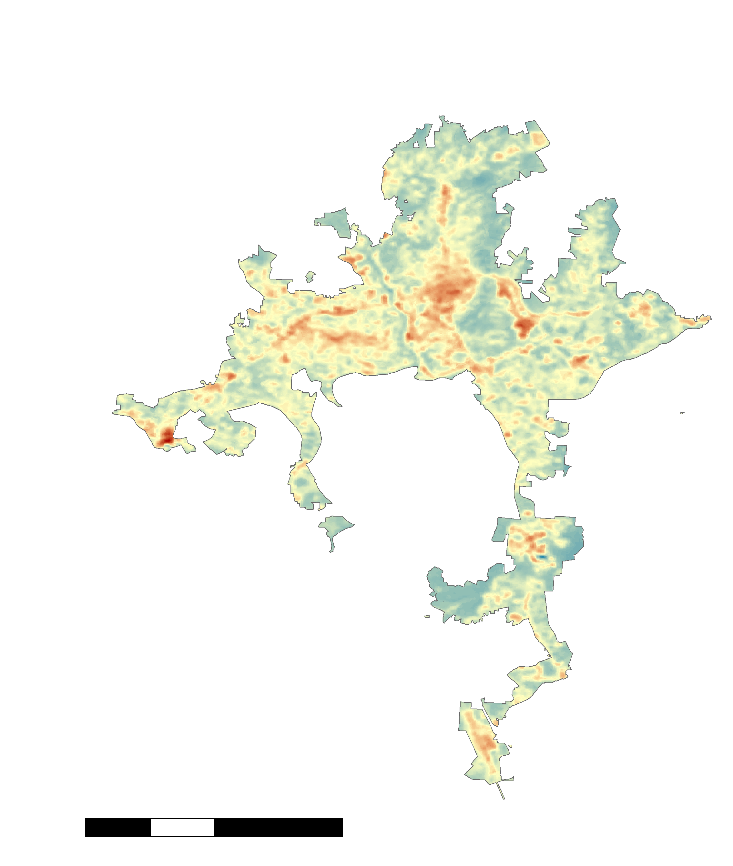
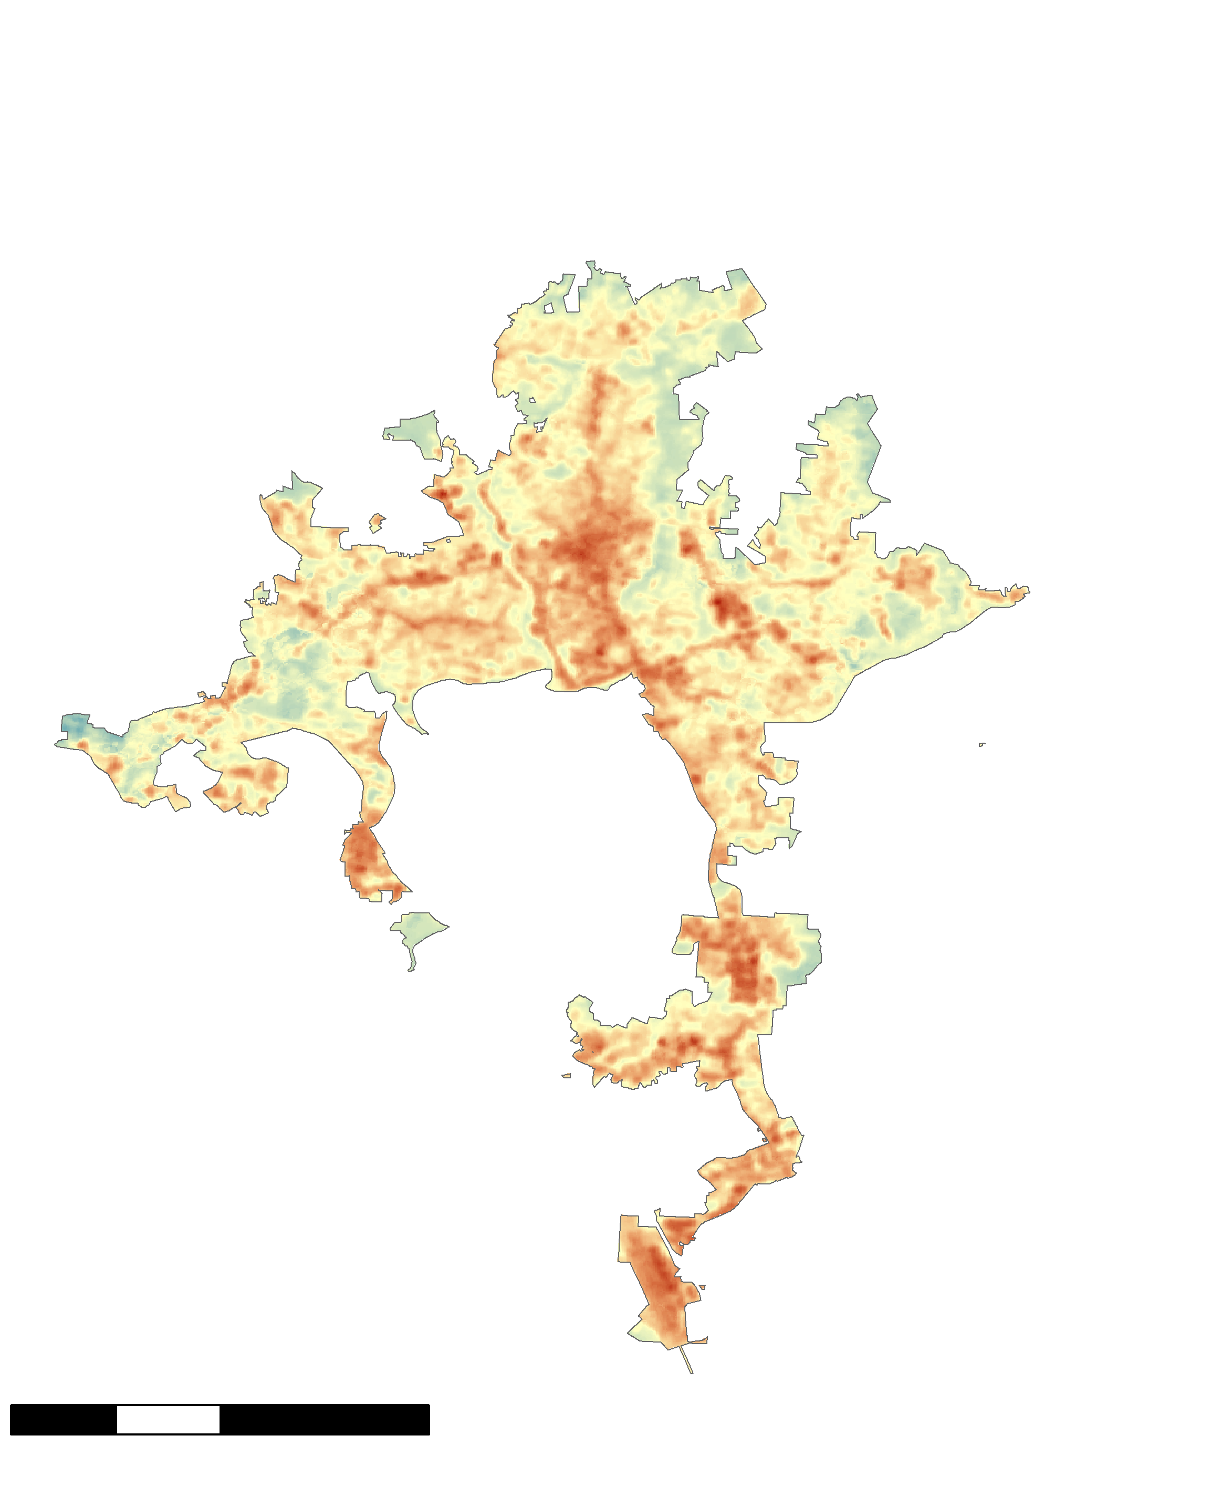
35- YEAR LAND SURFACE TEMPERATURE CHANGE IN ASHEVILLE
Median LST 1984-1986
Median LST 2017-2019
N
N
LST
High: 95° F
Low: 56° F
0 2.5 5 10
km
0 2.5 5 10
km
Notes:
So this map shows median day time land surface temperatures for Asheville from the warm months (may-September) of 1984-1986. You can see that there’s tremendous variation across the city, with the lowest surface temperatures being in the 50s and 60s, and some spots in the 90s. The second map shows the same thing for 2017-2019.
This map is set to the same color scale and you can start to see where things are heating up, with some spots experiencing as much as 31 degrees F.
From this map, you can see that areas like the outlet mall and the space surrounding downtown and the major road corridors are really experiencing a lot more heat when it comes to LST. Again this is not a map of climate change in Asheville, and this change has to do with the changes in Land cover, so changes in roads and buildings and parking lots and fields of grass and forested areas.
So how does this all relate? We wanted to know whether these differences in temperature across the city are related to tree cover specifically, and what that relationship looks like.

Slide 4
CORRELATION BETWEEN TREES AND LST
Mean LST by Block Group, 2017-2019
( ℉ )
Percent Tree Cover by Block Group, 2018
Notes:
R squared value = 0.5374
Y = -0.1225x + 82.785
Amy: We know, as thing Shirley pointed out in her presentation was that trees (moderate local climate) provide cooling effects that mitigate heat. We wanted to look at how trees relate to LST, and the bulk of our analyses are based on census block groups because we’ll be looking at population data later on. As you can see in this scatterplot, we found a strong correlation between present-day tree cover and LST by block groups in Asheville. You can see that in the block group with the least tree cover, the LST is highest, and for those block groups with extremely high canopy cover, there are lower land surface temperature values. Between these values, you can see the points fall on a pretty tight line, representing a strong correlation.
Amiya:
Having found a significant correlation between temperature and tree cover, we wanted to see how that information might specifically affect people living in Asheville
Image Credit: Amy Kennedy, DEVELOPer
What you’re looking at here is a scatterplot:

Slide 5
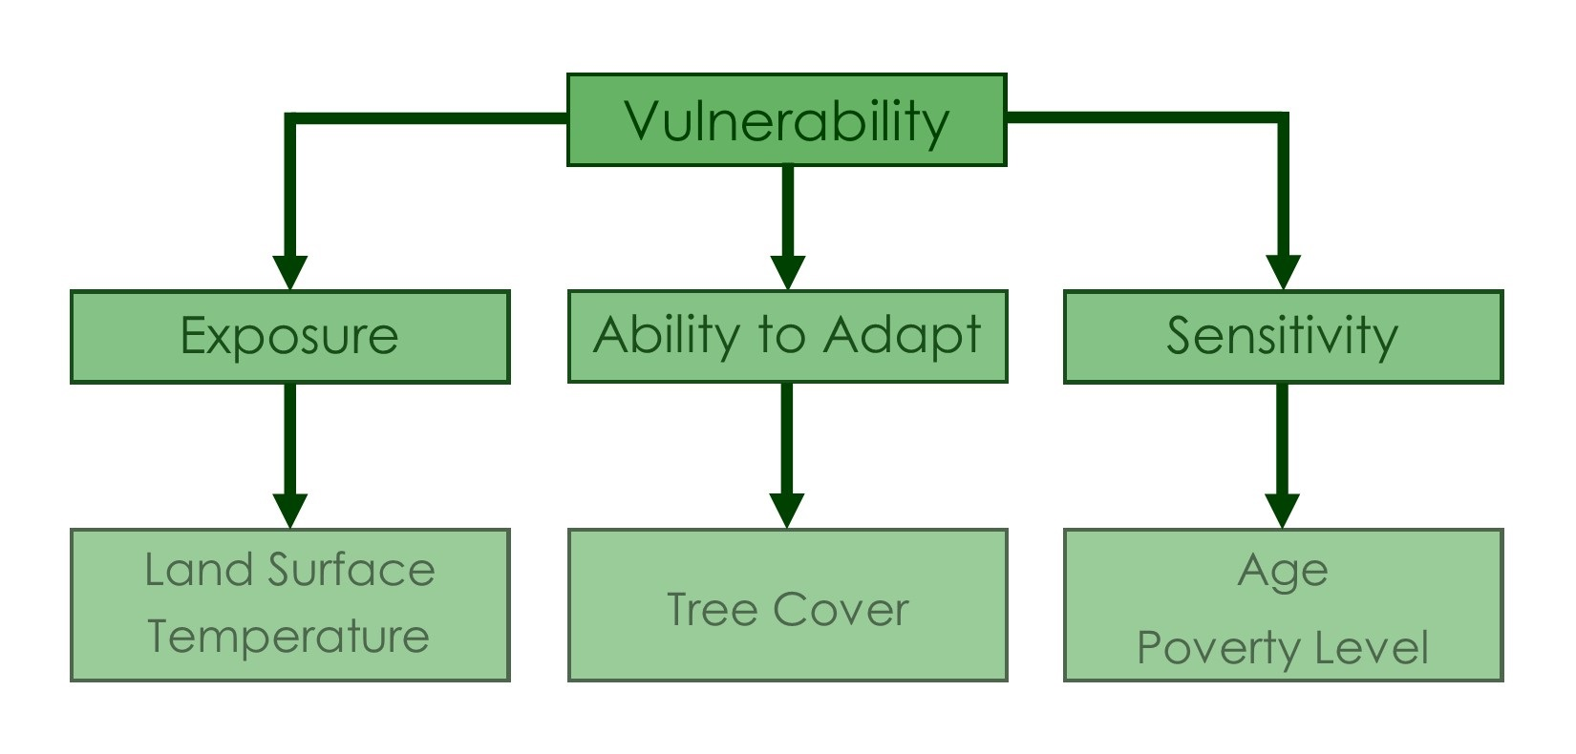
HEAT VULNERABILITY INDEX
Notes:
To answer that question, we built a heat vulnerability index – we’ll show you a map of it in a bit. Other studies that involved vulnerability indices like this one have defined vulnerability as the combination of exposure, sensitivity, and ability to adapt to a situation. We did the same thing with ours – each factor we included in the index represented one of those three things. We used land surface temperature for exposure, tree cover for ability to adapt, and age and poverty as sensitivity. In the next few slides we’ll go through and explain each one more thoroughly.

Slide 6

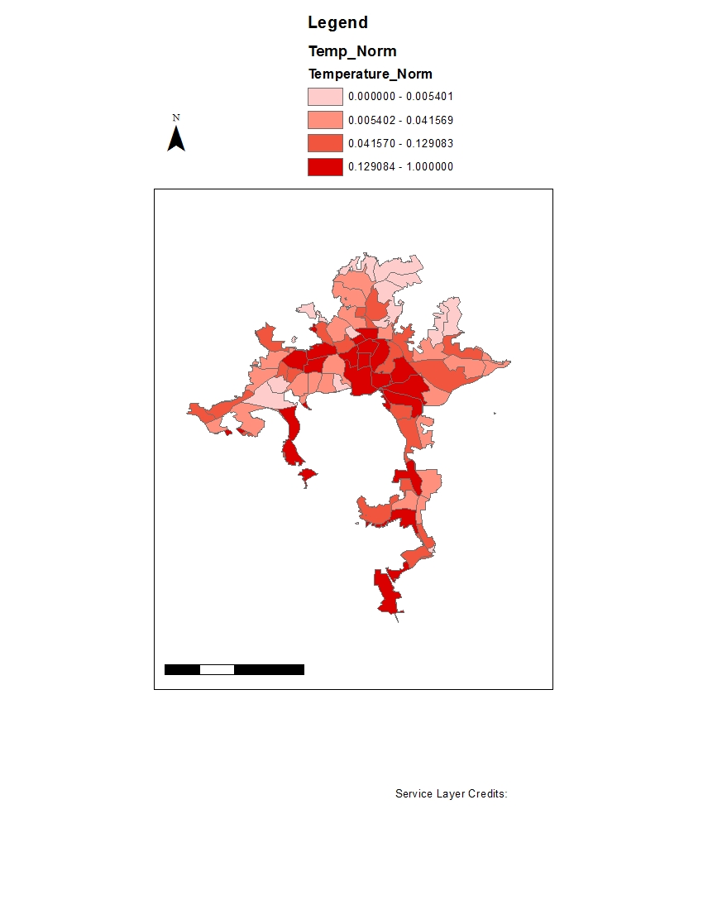
EXPOSURE: LAND SURFACE TEMPERATURE
N
Heat Exposure
Highest
Lowest
0 2.5 5 10
km
Notes:
So to look at vulnerability, we first input that satellite-derived land surface temperature into our index. This map shows the 85 census block groups in Asheville color coded by land surface temperature. So the dark red are the hottest block groups and the lightest are the coolest. This is based off of the same data we looked at before, so again you’re seeing
patters where around downtown and parts of south and west Asheville it’s particularly hot .

Slide 7

ADAPTIVE CAPACITY:TREE COVER
N
Tree Cover
Highest
0 2.5 5 10
km
Lowest
Notes:
We then took percent tree cover by census block group and used this variable in the index as well. On this map, the lighter colors represent least amount of tree cover and the darker colors correlate with highest percent of tree cover. You can see that the northeast parts of the city are more wooded, and areas close to the airport at the bottom of the map and downtown in the center of the map have the least tree cover, which makes sense because there is a lot of development in those areas.

Slide 8

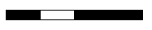
SENSITIVITY: SOCIOECONOMIC FACTORS
N
Social Vulnerability
Highest
0 2.5 5 10
km
Lowest
Notes:
The socioeconomic variables we included in this index are age and poverty. As people get older, they’re more likely to have health issues that can be caused or exacerbated by extreme heat, so areas with a lot of older people are more sensitive to heat. And people with lower incomes don’t necessarily have the resources that other people have to help them escape heat or make it more bearable, which can also lead to health problems because of the heat.
So on this map of Asheville block groups, the block groups that are marked with a darker blue are the areas with higher percentages of people who are above the age of 65 or living below the poverty line, which represents our definition of social vulnerability. This variable is different from the temperature and tree cover variables – there isn’t any clear pattern showing which areas are more or less vulnerable.

Slide 9
Overall Heat Vulnerability
Socioeconomic
Factors
Overall Heat
Vulnerability
Land Surface Temperature
Highest
Lowest
0 2.5 5 10
km
0 2.5 5 10
km
Tree Cover
Notes:
To make the overall heat vulnerability index, we combined all three factors – we took temperature, tree cover, and social vulnerability and combined them to get this final map. So our overall heat vulnerability index takes into account all three of those individual factors to show which parts of Asheville are most vulnerable to extreme heat from urban heat islands.
This final map shows the city of Asheville, divided into census block groups, and each block group is assigned one of four colors – the darker the color, the more vulnerable the people living there are to urban heat. For context –
This is where we are – A-B Tech.
This is the downtown area.
This is the outlet mall.
This is the Asheville airport.
This is UNCA.
Because this map shows which parts of Asheville are the most vulnerable to urban heat, organizations like the Urban Forestry Commission and Greenworks can be used to find areas that might be in greater need of support during warm months – that could mean anything from establishing childcare programs in air-conditioned spaces to installing local cooling centers to planting more trees.

Slide 10
IMPLICATIONS & FUTURE WORK
N
Overall Heat
Vulnerability
Highest
Lowest
0 2.5 5 10
km
Notes:
The reason why this project was established is because Asheville is a growing city, showing a population growth of 50% in the last 30 years (maybe take out?). Since 2008, there has been a population growth of 10% and a tree cover loss of roughly 6.4% in the city. With a growing population demanding more buildings and other impervious surfaces, which absorb heat and contribute to UHIs, the presence of trees and their cooling effects are crucial to offset this heat.
It’s important to keep in mind that climate change is its own global phenomenon, and that these results are hyper-localized and focus on the microclimate of Asheville directly related to UHI. However, while we would see these changes in land surface temperature without any outside influence, climate change will make the effects of UHI even more drastic.
This research opens the door to a lot of great questions and potential project ideas. While this is the end of our 10 weeks working on this project, these ideas can be something others can talk about in the future!

Slide 11
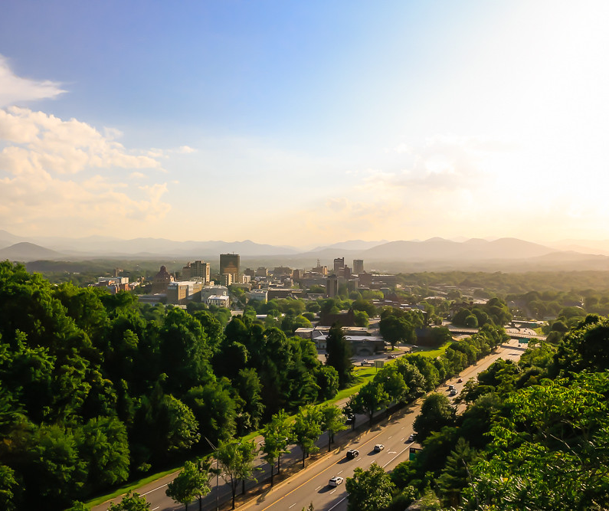
THANK YOU
NASA DEVELOP Contact Information
  develop.northcarolinancei@gmail.com
Asheville Urban Forestry Commission
Image Credit: Ken Lane via Flickr
Notes:
Thank you for your time and for being here today. If you have questions regarding our work, you can reach out to our program’s contact information provided here. We would also like to thank our fellow Andrew Shannon, our science advisor Scott Stevens, and our partners at the Urban Forestry Commission, who will be receiving our results and data. You can contact them afterwards for more information. Thank you!
https://www.nps.gov/mora/learn/nature/trees.htm > photo source

